Slide 1

Title
Sensory Detector of Hazardous Gases in Poultry Farm
Supervisor: Dr. Sudhakar K B, Professor
Harini N - 2127200601029
Ashwanthram T - 2127200601007
Hareesh V – 2127200601027

Slide 2
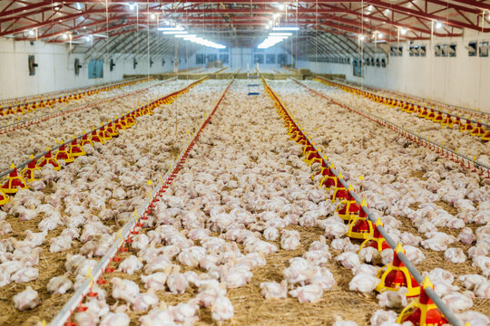
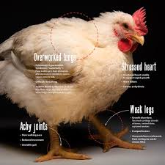
Problem definition
Create a automatic sensor model to address ammonia/H₂S gas emissions from bird litter in poultry sector.
Prolonged exposure can cause the following health hazardous
lower weight gain
higher FCR
decreased animal welfare
severe sores on breast and feet
It can also pose serious health hazards on the personnels

Slide 3
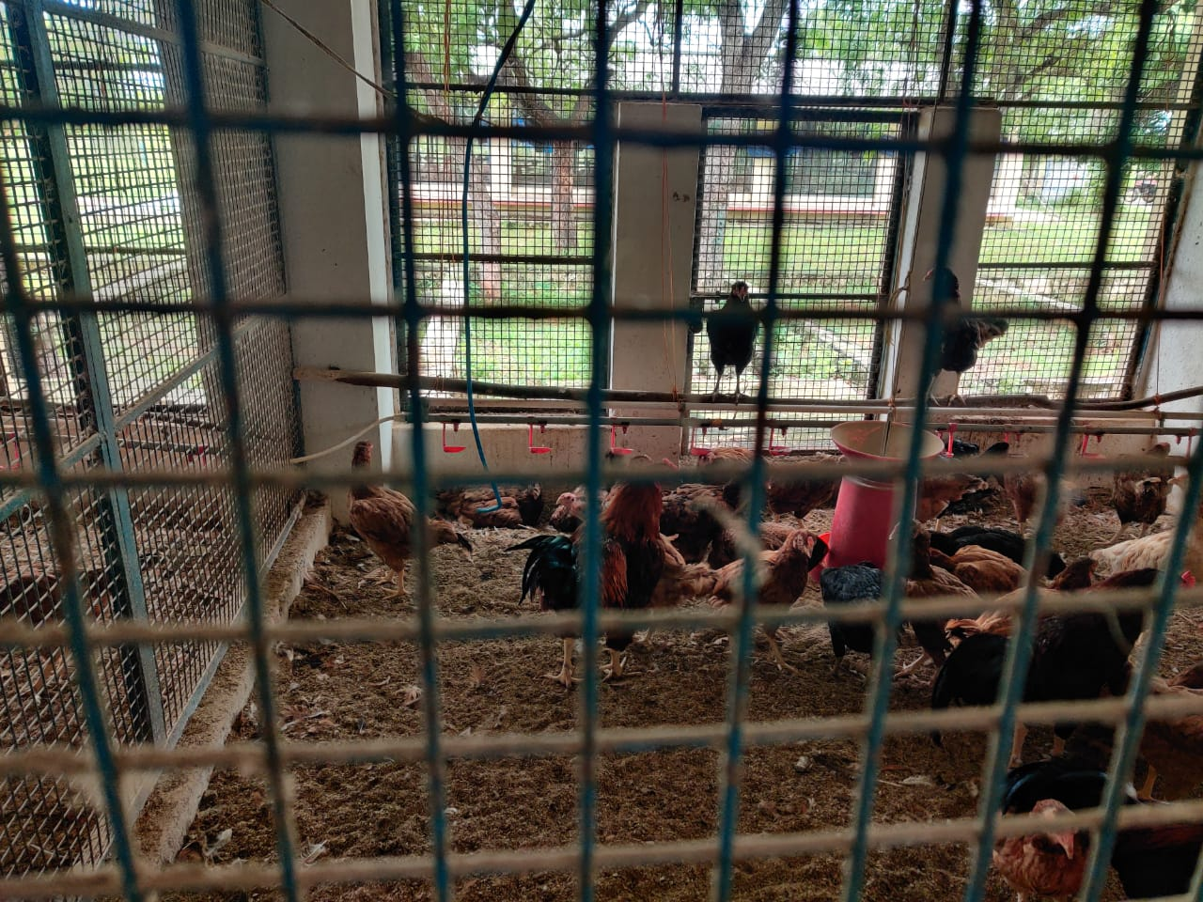
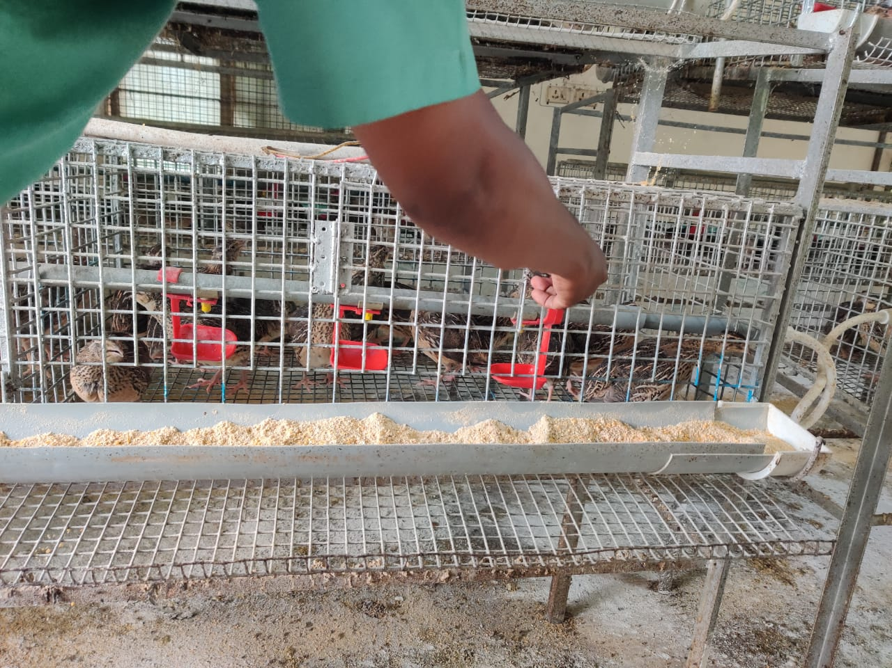
Insights from site visit
Poultry stocks are grown in two types of cages
Deep litter cages (weight of chicken >2.5 kg)
Metal cages
Deep litter cage Metal cage

Slide 4
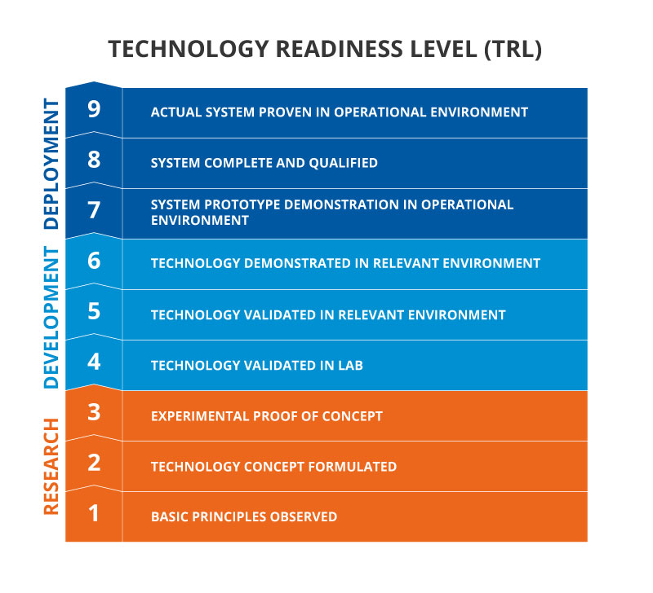
Proposed Solution and TRL
Sensor fabrication
ZnO thin films using RF sputtering
Electrical characterization of thin films
Fabrication of a ZnO based FET using Photolithography
Electrical performance of FET
Measurement and calculation of sensitivity and selectivity
Amplifier circuit
Design of amplifier circuit
Simualtion
Fabrication of PCB
Testing
Readout circuit and alarm using microcontroller
Technology Readiness Level - Completed till TRL 4

Slide 5
Research - Literature survey - Gas sensor
ZnO-based gas sensors have been widely used due to
fast response (ON/OFF ratio 10⁷)
low detection concentration capability (1 ppm)
high selectivity (mobility of the order of 100 cm²/V-s)
reliable performance and low manufacturing cost.
Possible gases that can be detected by ZnO based gas sensor - NH₃, NO_{x}, SO_{x}, H₂, H₂S, CO, CO₂, CH₄ and many more

Slide 6
Market study
India now ranks 3rd globally in egg production and 5th in chicken meat production
Egg capital of India - Namakkal
3.6 Crore farmers do poultry farming out of which 80% do it on a commercial scale
The poultry population increased from 3 lakh birds in 1975 to 4.5 crore in 2023
Oil and gas industry, power plants, sewage treatment plants, animal husbandry, metal production and processing industries, mines etc.

Slide 7
Research - Literature survey - Amplifier
TITLE: Design of Programmable Gain Amplifier Module in Dynamic Liquid Level Tester Published: 6 December 2020 doi:10.1088/1742-6596/1894/1/012027 | AUTHORS: Jiatian ZHANG, Hongwei QIN, Zhengguo YAN | INFERENCE: The Program Controlled Gain Amplifier (PGA) module designed in this paper is used in the dynamic liquid level test instrument. Using STM32F4O7ZGT6 as a microcontroller (MCU), the MCU, a multi-stage variable gain amplifier and a peak detection circuit form a closed loop control, forming an automatic gain control (AGC) circuit.

Slide 8
Development
TFT based gas sensor
RF sputtering for depositing ZnO over SiO₂
Photolithography for making contacts
Amplifier
Proteus 8 pro for simulation of the amplifier circuit
KiCAD for PCB design
Read out ciruit and alarm system
TFT based gas sensor
Trans-impedance amplifier
Micro controller
Gas
Current
Voltage
Read-out & alarm signal

Slide 9

Fabrication of gas sensor
RF sputtering
SiO₂ is grown over Si wafer
ZnO is deposited over substrate at 300º C
XRD and Hall measurement
Wurtzite structure
Mobility - 29.2 cm²/Vs (Lit. - 17.3)
Sheet resistance - 85.6E+3 Ω/sq (20E+3)
Photolithography
Mask was designed with different W/L ratio - 50/50, 100/25, 75/25, 100/40 etc
IV characterization
50/50 best configuration
ON/OFF ratio - 10⁵
Subthreshold voltage - 2.5V
Testing

Slide 10
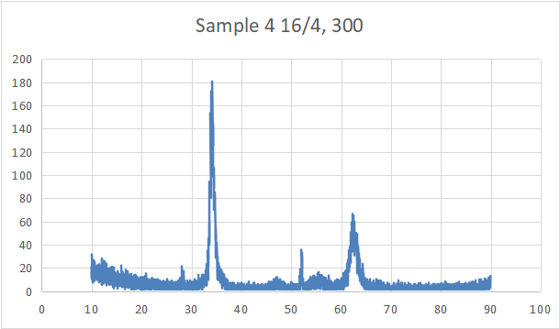
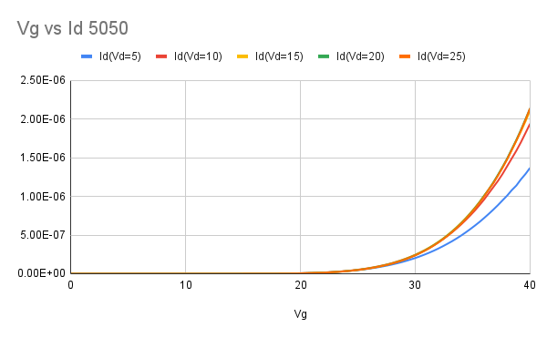
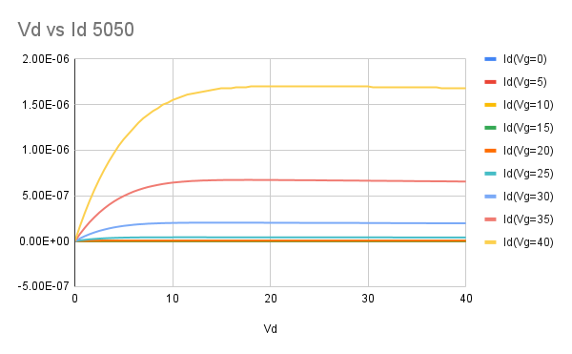
XRD result and IV
002
XRD results - intensity Vs Bragg’s angle
002 - hexagonal wurtzite structure
103
Transfer characteristics
Drain characteristics

Slide 11
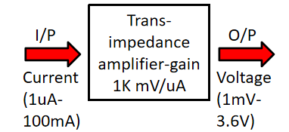
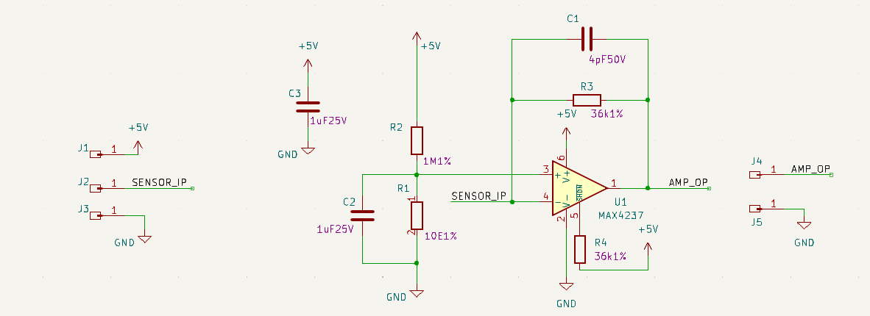

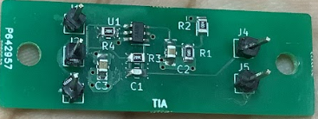
Amplifier circuit
The amplifier circuit was simulated using Proteus 8 pro
The printed circuit board was designed using KiCAD
PCB POWER
Fig. Schematic diagram of the amplifier circuit
Fig. Layout of the amplifier circuit
PCB of amplifier circuit

Slide 12

Microcontroller
STM32G071 is used
Alarm when gas concentration exceeds critical exposure limit
TM1637 to display the instantaneous gas concentration
Can be extended to exhaust fans
Microcontroller with amplifier and display unit

Slide 13
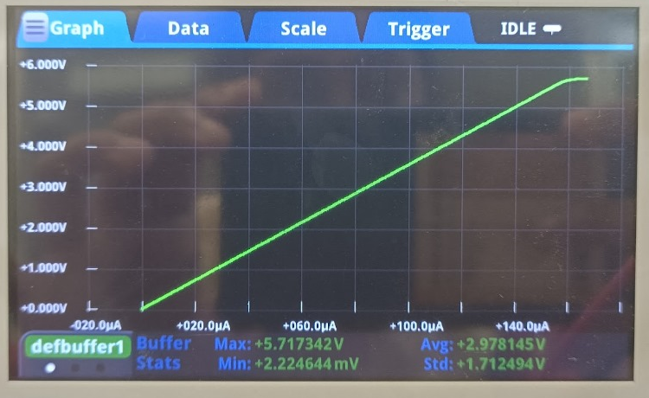
Technology validation in lab - TRL 4
Testing of the Amplifier circuit with Keithley’s SMU

Slide 14

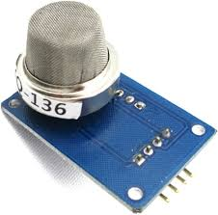
Comparision with existing work
Existing Sensor | Proposed work
Material: SnO₂ | Material: ZnO
Two terminal device | Three terminal device for better control
Cost: ₹ 1600 (aprox) | Indigenous Development of sensor - Cost reduction
MQ 137(NH₃) MQ 136(H₂S) | ZnO TFT based gas sensor

Slide 15
Why is three terminal favourable?
High Sensitivity
Fast Response Time
Selectivity
Wide Operating Range
Low Noise
Integration Potential
Long-Term Stability
Application Flexibility

Slide 16
References
[1] Yanli Kang, Feng Yu, Lu Zhang, Wenhao Wang, Long Chen, Yingchun Li,Review of ZnO-based nanomaterials in gas sensors, Solid State Ionics, Volume 360, 2021, 115544, ISSN 0167-2738,https://doi.org/10.1016/j.ssi.2020.115544.
[2] D. Punetha and S. K. Pandey, "CO Gas Sensor Based on E-Beam Evaporated ZnO, MgZnO, and CdZnO Thin Films: A Comparative Study," in IEEE Sensors Journal, vol. 19, no. 7, pp. 2450-2457, 1 April1, 2019, doi: 10.1109/JSEN.2018.2890007.
[3] X. Pan, X. Zhao, A. Bermak and Z. Fan, "A Humidity-Insensitive NO2 Gas Sensor With High Selectivity," in IEEE Electron Device Letters, vol. 37, no. 1, pp. 92-95, Jan. 2016, doi: 10.1109/LED.2015.2504260.
[4] Tarun Varma, C. Periasamy, Dharmendar Boolchandani, Performance evaluation of bottom gate ZnO based thin film transistors with different W/L ratios for UV sensing, Superlattices and Microstructures, Volume 114, 2018,
Pages 284-295, ISSN 0749-6036, https://doi.org/10.1016/j.spmi.2017.12.054.

Slide 17
References
[5] Vijjapu MT, Surya SG, Yuvaraja S, Zhang X, Alshareef HN, Salama KN. Fully Integrated Indium Gallium Zinc Oxide NO2 Gas Detector. ACS Sens. 2020 Apr 24;5(4):984-993. doi: 10.1021/acssensors.9b02318. Epub 2020 Feb 24. PMID: 32091191
[6] Bhowmik, B. Comparative Study of Thin-Film-Based Planar and Vertical Devices Towards Isopropyl Alcohol Sensing. J. Electron. Mater. 48, 7292–7301 (2019). https://doi.org/10.1007/s11664-019-07554-3
[7] Kandpal, K., Gupta, N. Study of structural and electrical properties of ZnO thin film for Thin Film Transistor (TFT) applications. J Mater Sci: Mater Electron 28, 16013–16020 (2017). https://doi.org/10.1007/s10854-017-7500-7
[8] Ting-Jen Hsueh, Cheng-Liang Hsu, Shoou-Jinn Chang, I-Cherng Chen, Laterally grown ZnO nanowire ethanol gas sensors, Sensors and Actuators B: Chemical, Volume 126, Issue 2, 2007, Pages 473-477, ISSN 0925-4005, https://doi.org/10.1016/j.snb.2007.03.034.

Slide 18
References
[9] AdriÃ¡n A. Camacho-BerrÃ­os, VÃ­ctor M. Pantojas, Wilfredo OtaÃ±o,
Reactive sputtered ZnO thin films: Influence of the O2/Ar flow ratio on the oxygen vacancies and paramagnetic active sites, Thin Solid Films, Volume 692, 2019, 137641, ISSN 0040-6090,https://doi.org/10.1016/j.tsf.2019.137641.
[10] Amirhosein Asilian, S. Mohammadali Zanjani, Design and fabrication of an amperometric CO gas sensor and a readout circuit using a low-noise transimpedance amplifier to achieve standard analog outputs,AEU - International Journal of Electronics and Communications,Volume 171, 2023, 154864, ISSN 1434-8411, https://doi.org/10.1016/j.aeue.2023.154864.
[11] J. Agrawal, M. Shukla and V. Singh, "Development of a Reliable Zinc Oxide Thin-Film-Based Ammonia Gas Sensor," in IEEE Sensors Letters, vol. 7, no. 2, pp. 1-4, Feb. 2023, Art no. 2000104, doi: 10.1109/LSENS.2023.3235890.
[12] Angelika Hackner, Benoit Bouxin, Gerhard MÃ¼ller, Surface ionisation gas detection: Vertical versus planar readout modes, Sensors and Actuators B: Chemical, Volume 188, 2013, Pages 286-292, ISSN 0925-4005, https://doi.org/10.1016/j.snb.2013.06.091.
[13] C Tsakonas et al 2017 J. Phys. D: Appl. Phys. 50 485306 DOI 10.1088/1361-6463/aa9316

